Slide 1
UPPER SIXTH ARTS
GEOGRAPHY
Lesson 8
Strategies of Development
Notes:
Good morning, class, and welcome to our geography lesson. I am your geography teacher, Mr Kamdem. Today we are starting Lesson 8: Strategies of Development.

Slide 2
CLASS INFO
Class, Chapter and Duration
Class | Upper Sixth Arts
Chapter | Module 7: Understanding and managing contemporary environmental and development issues
Duration | 2 periods (2 × 50 minutes)
Notes:
This lesson is for Upper Sixth Arts. It belongs to Module 7: Understanding and managing contemporary environmental and development issues. We shall need 2 periods to cover it.

Slide 3
IDENTIFICATION
Lesson Identification
Topic | Current Development Issues
Sub-topic | Global Strategies to Redress Underdevelopment
Lesson | Lesson 8: Strategies of Development
Notions / Concepts | Millennium Development Goals, Sustainable Development Goals, epidemiological transition, gender, empowerment.
Syllabus focus | The MDGs; health and development and the epidemiological (health) transition; the role of women in development; the SDGs.
Competence | Learners are able to explain global development strategies and the role of health and women in development.
Notes:
Our topic is Current Development Issues, and the sub-topic is Global Strategies to Redress Underdevelopment. The key notions we shall use today are: millennium Development Goals, Sustainable Development Goals, epidemiological transition, gender, empowerment. At the end, you should be able to do this: learners are able to explain global development strategies and the role of health and women in development.

Slide 4

HOMEWORK CORRECTION
Correction of the Homework
Question (Lesson 7: Notion of Development):
Compare Cameroon with one African country using three development indicators.
Notes:
Before we start the new lesson, let us correct the homework I gave you at the end of Lesson 7: Notion of Development. The question was: Compare Cameroon with one African country using three development indicators. Take out your exercise books.

Slide 5
HOMEWORK CORRECTION
Correction: Possible Answer
Example: Cameroon vs Gabon — GNI per person about 1,600 US$ vs about 8,000 US$; life expectancy about 61 vs 67 years; HDI about 0.59 vs 0.69. Gabon is more developed thanks to oil and a small population.
Notes:
Here is a good answer. Example: Cameroon vs Gabon — GNI per person about 1,600 US$ vs about 8,000 US$; life expectancy about 61 vs 67 years; HDI about 0.59 vs 0.69. Gabon is more developed thanks to oil and a small population. Compare it with your own answer and correct your work in red.

Slide 6
LESSON PLAN
Lesson Plan
Correction of the homework
Objectives and recall
Real-life situation and action to take
Learning activities
Board summary
Evaluation, remediation and homework
Notes:
Here is the plan of our lesson today. First, we shall correct the homework. Then we shall look at the objectives and recall what you already know. After that, we shall study a situation from real life and the action to take, and do the learning activities. Finally, we shall copy the board summary, do the evaluation and the remediation, and I will give you the homework.

Slide 7
OBJECTIVES
Objectives
By the end of this lesson, you should be able to:
Describe the MDGs and the SDGs.
Explain the epidemiological transition.
Explain the role of women in development.
Notes:
By the end of this lesson, you should be able to do three things. Number 1: describe the MDGs and the SDGs. Number 2: explain the epidemiological transition. Number 3: explain the role of women in development.

Slide 8
PREVIOUS KNOWLEDGE
Previous Knowledge
Development means a better life.
Health and education are measures of development.
Notes:
Let us first remember what you already know. Development means a better life. Health and education are measures of development. Keep this in mind, because we shall build on it today.

Slide 9
REAL-LIFE SITUATION
Situation in Real Life
In a village near Garoua, a new health centre has reduced malaria deaths, and a women's group sells groundnuts to pay school fees. These actions help the country reach the Sustainable Development Goals.
Notes:
Listen carefully to this situation from real life. In a village near Garoua, a new health centre has reduced malaria deaths, and a women's group sells groundnuts to pay school fees. These actions help the country reach the Sustainable Development Goals. Think about it, because I am going to ask you some questions.

Slide 10
REAL-LIFE SITUATION
Situation: Question 1
What is the problem in the situation?
Notes:
Question 1: What is the problem in the situation? Think for a moment, then raise your hand to answer.

Slide 11
REAL-LIFE SITUATION
Answer
How to improve health and incomes to develop.
Notes:
Good. How to improve health and incomes to develop.

Slide 12
REAL-LIFE SITUATION
Situation: Question 2
Which world goals are mentioned?
Notes:
Question 2: Which world goals are mentioned? Think for a moment, then raise your hand to answer.

Slide 13
REAL-LIFE SITUATION
Answer
The Sustainable Development Goals (SDGs).
Notes:
Good. The Sustainable Development Goals (SDGs).

Slide 14
REAL-LIFE SITUATION
Situation: Question 3
What role do women play?
Notes:
Question 3: What role do women play? Think for a moment, then raise your hand to answer.

Slide 15
REAL-LIFE SITUATION
Possible Answer
They earn money and pay for their children's education.
Notes:
Good. They earn money and pay for their children's education.

Slide 16
ACTION TO TAKE
Action to Take
Support health care and the education of girls in your community.
Notes:
From this situation, the action we are working towards in this lesson is the following: support health care and the education of girls in your community.

Slide 17
JUSTIFICATION
Justification of the Lesson
This lesson helps us to understand world strategies to fight underdevelopment.
Notes:
Why is this lesson important for you? This lesson helps us to understand world strategies to fight underdevelopment.

Slide 18
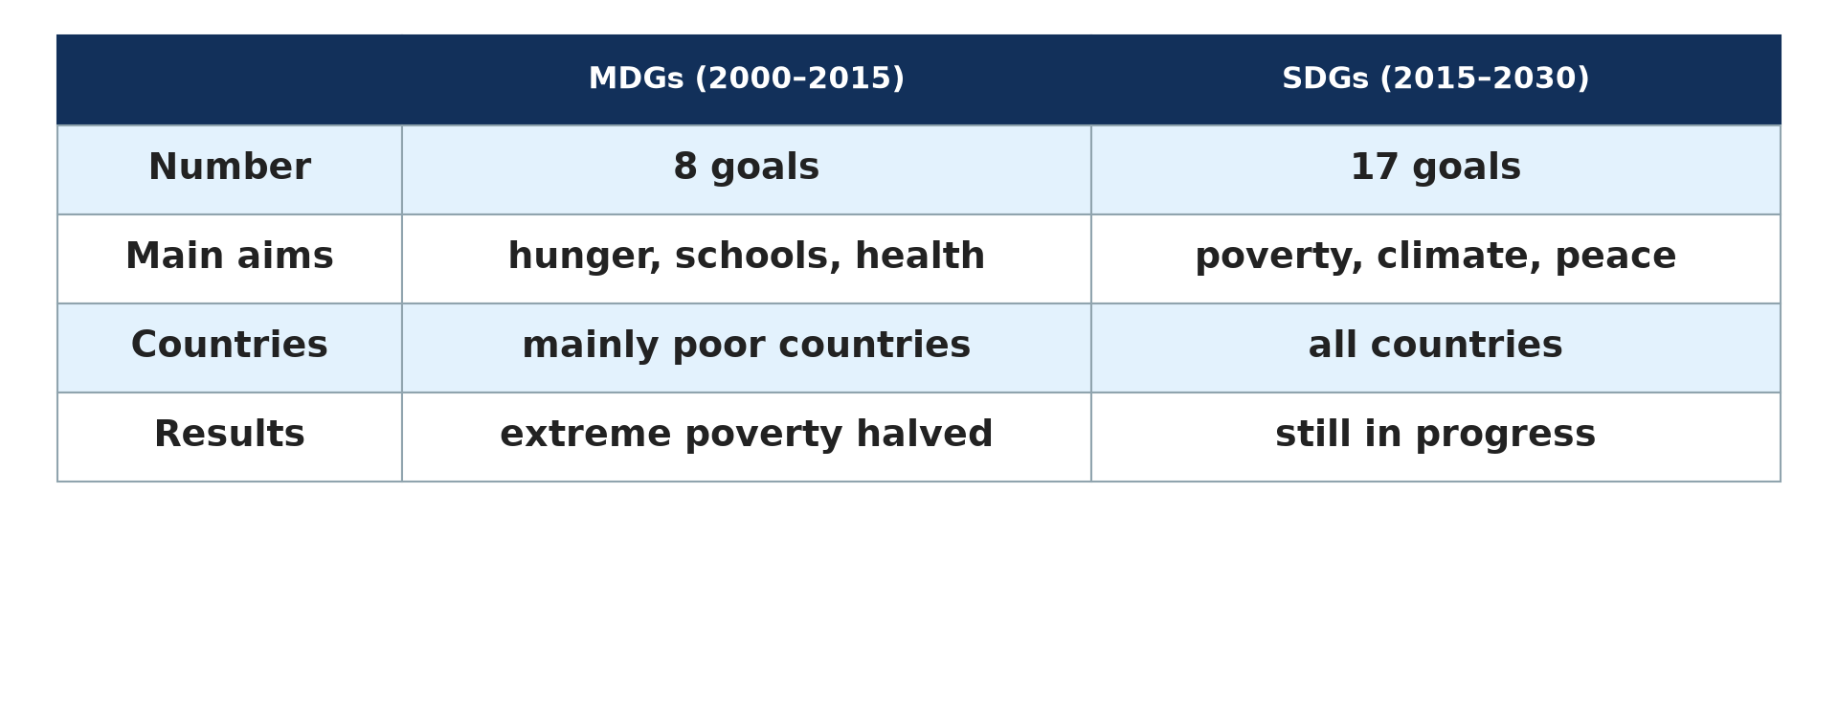
1. MDGs AND SDGs
Activity 1
MDGs and SDGs compared.
Notes:
Activity 1. Look carefully at this diagram: mDGs and SDGs compared. Observe every detail before I ask the question.

Slide 19
1. MDGs AND SDGs
Activity 1: Question
Give two differences between the MDGs and the SDGs.
Notes:
Here is the question for Activity 1: Give two differences between the MDGs and the SDGs. Take one minute to think and write your answer in your rough notebook.

Slide 20
1. MDGs AND SDGs
Activity 1: Answer
MDGs had 8 goals for poor countries; SDGs have 17 goals for all countries.
Notes:
Let us check the answer together. MDGs had 8 goals for poor countries; SDGs have 17 goals for all countries.

Slide 21
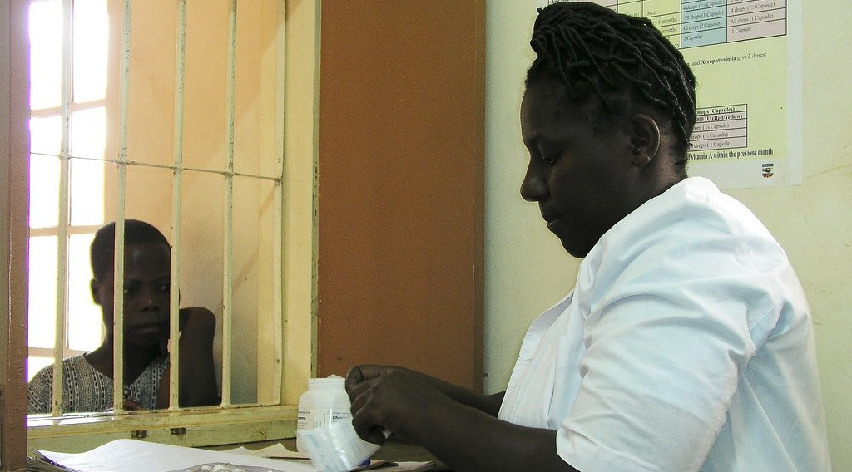
2. HEALTH AND DEVELOPMENT
Activity 2
Patients at a health centre.
Notes:
Activity 2. Look carefully at this picture: patients at a health centre. Observe every detail before I ask the question.

Slide 22
2. HEALTH AND DEVELOPMENT
Activity 2: Question
Why is health important for development?
Notes:
Here is the question for Activity 2: Why is health important for development? Take one minute to think and write your answer in your rough notebook.

Slide 23
2. HEALTH AND DEVELOPMENT
Activity 2: Answer
Healthy people can work, learn and produce more.
Notes:
Let us check the answer together. Healthy people can work, learn and produce more.

Slide 24
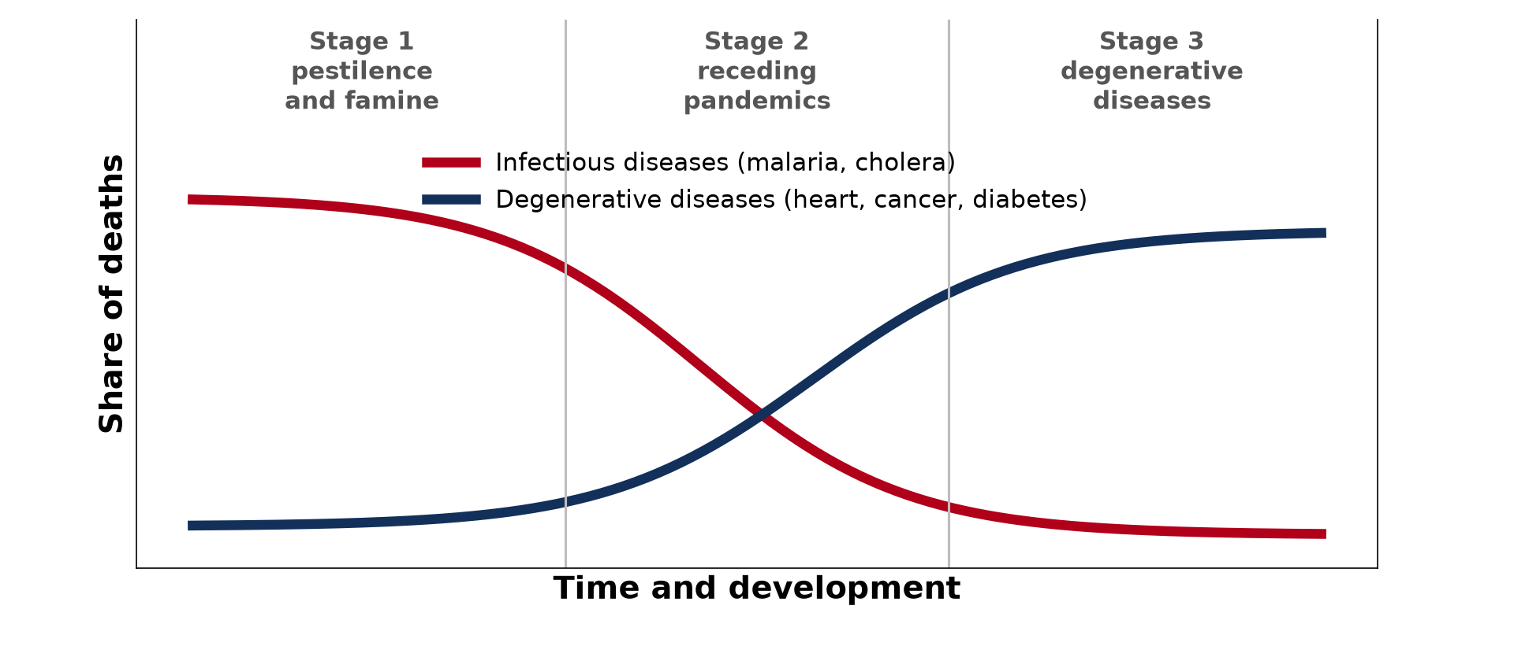
2. THE HEALTH TRANSITION
Activity 3
The epidemiological transition.
Notes:
Activity 3. Look carefully at this diagram: the epidemiological transition. Observe every detail before I ask the question.

Slide 25
2. THE HEALTH TRANSITION
Activity 3: Question
What happens to causes of death as countries develop?
Notes:
Here is the question for Activity 3: What happens to causes of death as countries develop? Take one minute to think and write your answer in your rough notebook.

Slide 26
2. THE HEALTH TRANSITION
Activity 3: Answer
Infectious diseases fall and degenerative diseases like heart disease rise.
Notes:
Let us check the answer together. Infectious diseases fall and degenerative diseases like heart disease rise.

Slide 27
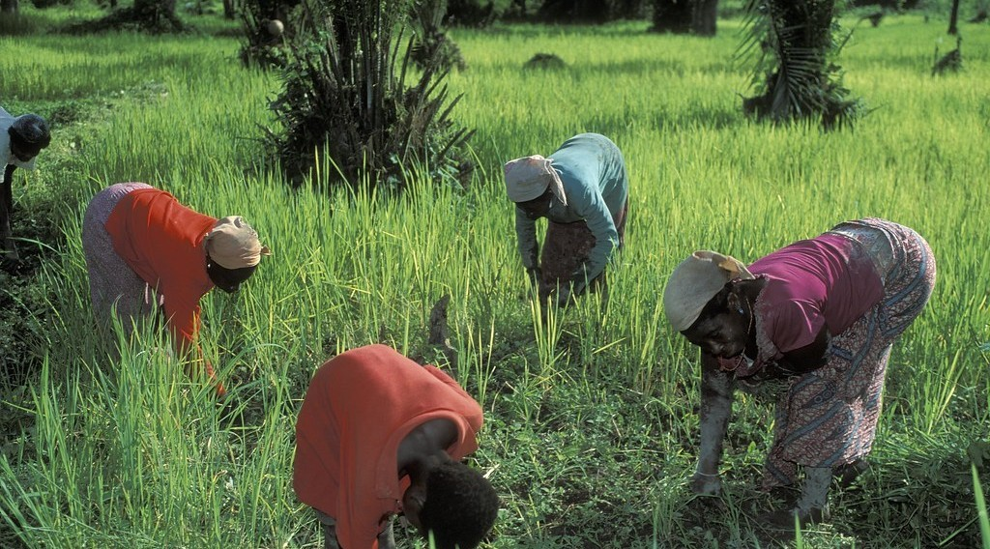
3. WOMEN IN DEVELOPMENT
Activity 4
Women working on crops.
Notes:
Activity 4. Look carefully at this picture: women working on crops. Observe every detail before I ask the question.

Slide 28
3. WOMEN IN DEVELOPMENT
Activity 4: Question
Give two roles of women in development.
Notes:
Here is the question for Activity 4: Give two roles of women in development. Take one minute to think and write your answer in your rough notebook.

Slide 29
3. WOMEN IN DEVELOPMENT
Activity 4: Answer
They produce most food and care for family health and education.
Notes:
Let us check the answer together. They produce most food and care for family health and education.

Slide 30
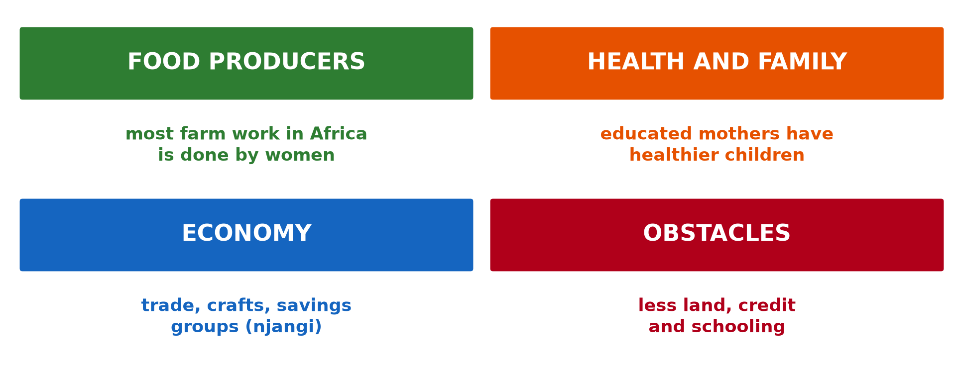
3. OBSTACLES FACING WOMEN
Activity 5
Roles and obstacles.
Notes:
Activity 5. Look carefully at this diagram: roles and obstacles. Observe every detail before I ask the question.

Slide 31
3. OBSTACLES FACING WOMEN
Activity 5: Question
Give two obstacles faced by women.
Notes:
Here is the question for Activity 5: Give two obstacles faced by women. Take one minute to think and write your answer in your rough notebook.

Slide 32
3. OBSTACLES FACING WOMEN
Activity 5: Answer
Less access to land and credit (also schooling).
Notes:
Let us check the answer together. Less access to land and credit (also schooling).

Slide 33
BOARD SUMMARY
Board Summary
Topic: Current Development Issues
Sub-topic: Global Strategies to Redress Underdevelopment
Lesson 8: Strategies of Development
Notes:
Now we are going to copy the board summary. Write the title and the headings neatly in your notebooks. I will give you enough time for each slide, so do not rush.

Slide 34
BOARD SUMMARY
1. The MDGs and the SDGs
The global development goals are the following:
MDGs: They were 8 goals set by the UN for 2000–2015 to reduce poverty, hunger, disease and illiteracy. Extreme poverty was halved, but Africa did not meet most goals.
Notes:
Let us copy The MDGs and the SDGs. The global development goals are the following. On this slide we have MDGs. Write each point on a new line, with the key term first, and explain it in your own words when we revise. When you finish, we go to the next slide.

Slide 35
BOARD SUMMARY
1. The MDGs and the SDGs (continued)
SDGs: They are 17 goals set by the UN for 2015–2030 for all countries. They add climate, cities, peace and sustainable production to the fight against poverty.
Notes:
We continue with The MDGs and the SDGs. On this slide we have SDGs. Write each point on a new line, with the key term first, and explain it in your own words when we revise.

Slide 36
BOARD SUMMARY
1. The MDGs and the SDGs
Illustration: MDGs and SDGs compared
Notes:
Now draw this illustration in your notebook: mDGs and SDGs compared. Give it a title and label it clearly.

Slide 37
BOARD SUMMARY
2. Health and Development
Health and development are linked as follows:
Health and development: Healthy people work, learn and earn more. Development in turn gives money for clinics, clean water and good food.
Notes:
Let us copy Health and Development. Health and development are linked as follows. On this slide we have Health and development. Write each point on a new line, with the key term first, and explain it in your own words when we revise. When you finish, we go to the next slide.

Slide 38
BOARD SUMMARY
2. Health and Development (continued)
Epidemiological transition: As countries develop, infectious diseases like malaria and cholera decline. Chronic diseases like heart disease, cancer and diabetes become the main causes of death.
Notes:
We continue with Health and Development. On this slide we have Epidemiological transition. Write each point on a new line, with the key term first, and explain it in your own words when we revise.

Slide 39
BOARD SUMMARY
2. Health and Development
Illustration: the epidemiological transition
Notes:
Now draw this illustration in your notebook: the epidemiological transition. Give it a title and label it clearly.

Slide 40
BOARD SUMMARY
3. Women in Development
Women play roles and face obstacles in development:
Roles: Women produce much of the food in Africa, trade and care for health and education. Educated mothers have healthier children and smaller families.
Notes:
Let us copy Women in Development. Women play roles and face obstacles in development. On this slide we have Roles. Write each point on a new line, with the key term first, and explain it in your own words when we revise. When you finish, we go to the next slide.

Slide 41
BOARD SUMMARY
3. Women in Development (continued)
Obstacles: Many women lack land, credit and education, and suffer early marriage. Heavy domestic work and some traditions limit their participation.
Notes:
We continue with Women in Development. On this slide we have Obstacles. Write each point on a new line, with the key term first, and explain it in your own words when we revise. When you finish, we go to the next slide.

Slide 42
BOARD SUMMARY
3. Women in Development (continued)
Empowerment: Girls' education, access to credit and equal rights improve women's status. Women's groups and quotas in politics give them a voice.
Notes:
We continue with Women in Development. On this slide we have Empowerment. Write each point on a new line, with the key term first, and explain it in your own words when we revise.

Slide 43
BOARD SUMMARY
3. Women in Development
Illustration: roles of women and obstacles
Notes:
Now draw this illustration in your notebook: roles of women and obstacles. Give it a title and label it clearly.

Slide 44
FORMATIVE EVALUATION
Evaluation 1
Give two MDGs and two new areas of the SDGs.
Notes:
Now let us check what you have understood. Question 1: Give two MDGs and two new areas of the SDGs. Answer in your exercise book.

Slide 45
FORMATIVE EVALUATION
Expected Answer
MDGs: end hunger, schooling. SDGs: climate, peace.
Notes:
The expected answer is: mDGs: end hunger, schooling. SDGs: climate, peace. If you got it right, well done.

Slide 46
FORMATIVE EVALUATION
Evaluation 2
Explain the epidemiological transition.
Notes:
Now let us check what you have understood. Question 2: Explain the epidemiological transition. Answer in your exercise book.

Slide 47
FORMATIVE EVALUATION
Expected Answer
Deaths shift from infectious to degenerative diseases with development.
Notes:
The expected answer is: deaths shift from infectious to degenerative diseases with development. If you got it right, well done.

Slide 48
REMEDIATION
Remediation
Fill in the blanks:
The SDGs have ______ goals.
The MDGs ended in ______.
Loans for small businesses are ______.
Notes:
For those who need more practice, fill in the blanks in your exercise book. The answers are: number 1, 17; number 2, 2015; number 3, microcredit.

Slide 49
HOMEWORK
Homework
Choose one SDG and describe what your community does to achieve it.
Notes:
For your homework: Choose one SDG and describe what your community does to achieve it. We shall correct it at the beginning of our next lesson.

Slide 50
NEXT LESSON
Next Lesson
Our next lesson will be on:
Lesson 9: New Industrial Strategy for Development
Notes:
Our next lesson will be on Lesson 9: New Industrial Strategy for Development. Thank you for your attention, and see you next time.

Slide 51
BILINGUAL GAME
Bilingual Game (Jeu Bilingue)
English | Français
Goal | L'objectif
Health | La santé
Disease | La maladie
Women | Les femmes
Empowerment | L'autonomisation
Poverty | La pauvreté
Notes:
Let us play the bilingual game. I say a word in English, and you give me the French word. Then we do the reverse.

Slide 52
LOGBOOK
Official Logbook (1/2)
Module / Topic | Current Development Issues
Lesson Title | Lesson 8: Strategies of Development
Expected Learning Outcomes | Describe the MDGs and the SDGs. Explain the epidemiological transition. Explain the role of women in development.
Competence | Learners are able to explain global development strategies and the role of health and women in development.
Notes:
I record this information in the official logbook of the class after the lesson.

Slide 53
LOGBOOK
Official Logbook (2/2)
Matter Taught | The MDGs and the SDGs; Health and Development; Women in Development.
Evaluation | Formative evaluation and remediation exercise.
Homework | Choose one SDG and describe what your community does to achieve it.
Enrolment / Present / Absent | ____ / ____ / ____
Achievement | To be completed after the lesson.
Notes:
I complete the second page of the logbook: the matter taught, the evaluation, the homework and the attendance.

Slide 54
TEACHER'S NOTE
Teacher's Note
Timing: Homework correction, plan, objectives 8 min | Recall, situation, action 10 min | 5 activities 30 min | Board summary (copying) 30 min | Evaluation, remediation 10 min | Homework, next lesson 5 min | Logbook 7 min
Without the projector (Activity 1): read the table.
Without the projector (Activity 2): discuss local health centres.
Without the projector (Activity 3): read the curves.
Without the projector (Activity 4): discuss women's work.
Without the projector (Activity 5): suggest solutions.
Notes:
This slide is for me, the teacher: it gives the timing of the lesson and what to do if the projector is not available.

Slide 55
REFERENCES
References
National Geography Syllabus, MINESEC/IGE/IP-SS, 2019 — Module 7 (Environment and Development).
Photo, Activity 2: “Waiting at the dispensary” by World Bank Photo Collection, CC BY-NC-ND 2.0, via Flickr (https://www.flickr.com/photos/10816734@N03/7556643920)
Photo, Activity 4: “Women doing work on crops” by World Bank Photo Collection, CC BY-NC-ND 2.0, via Flickr (https://www.flickr.com/photos/10816734@N03/2073350635)
Diagrams and animations: drawn for this lesson (Geography Department).
Notes:
These are the references and picture credits used to prepare this lesson.

